Slide 1
X-sections K-L & M-N
See Cross section locations.kmz & Cross section labels.kmz for location in Google Earth

Slide 2
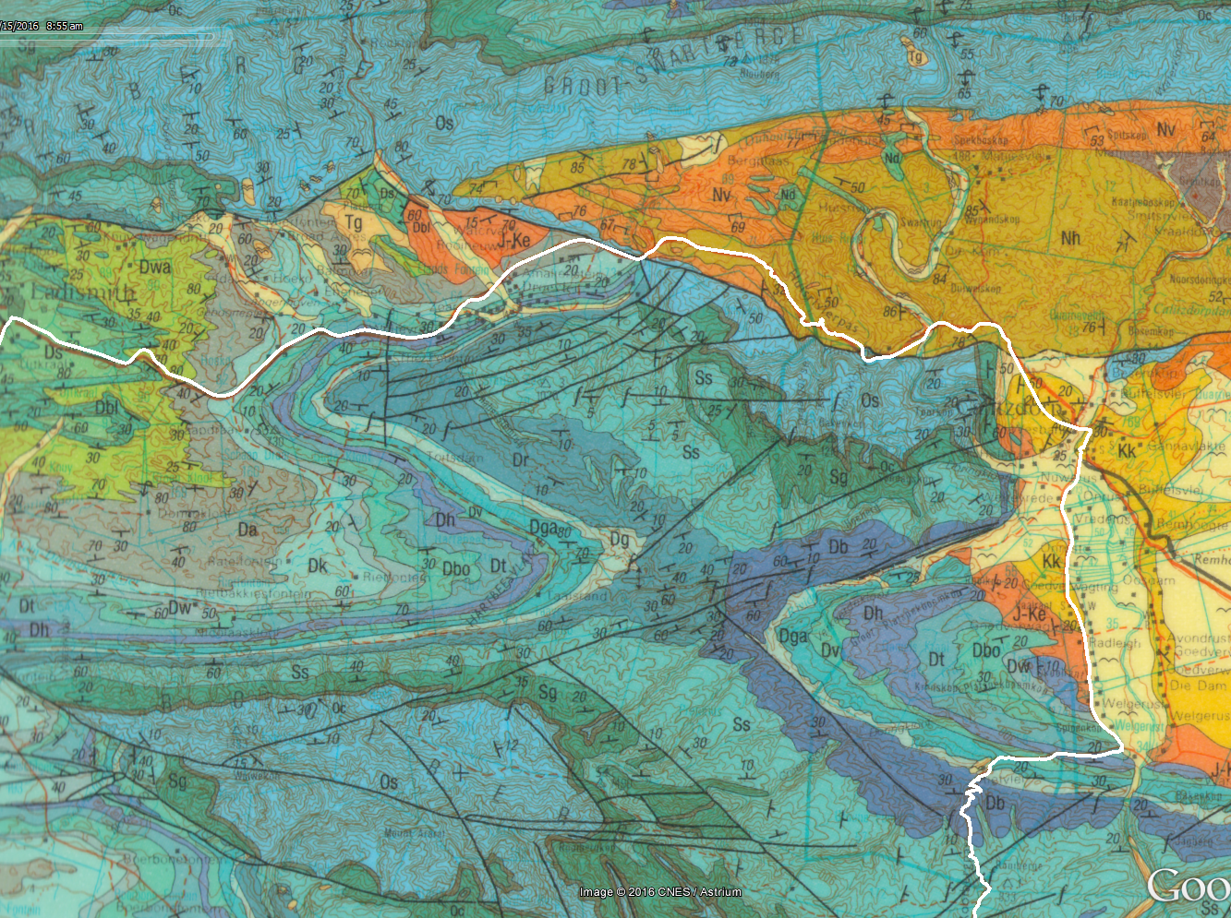
M
K
L
N

Slide 3
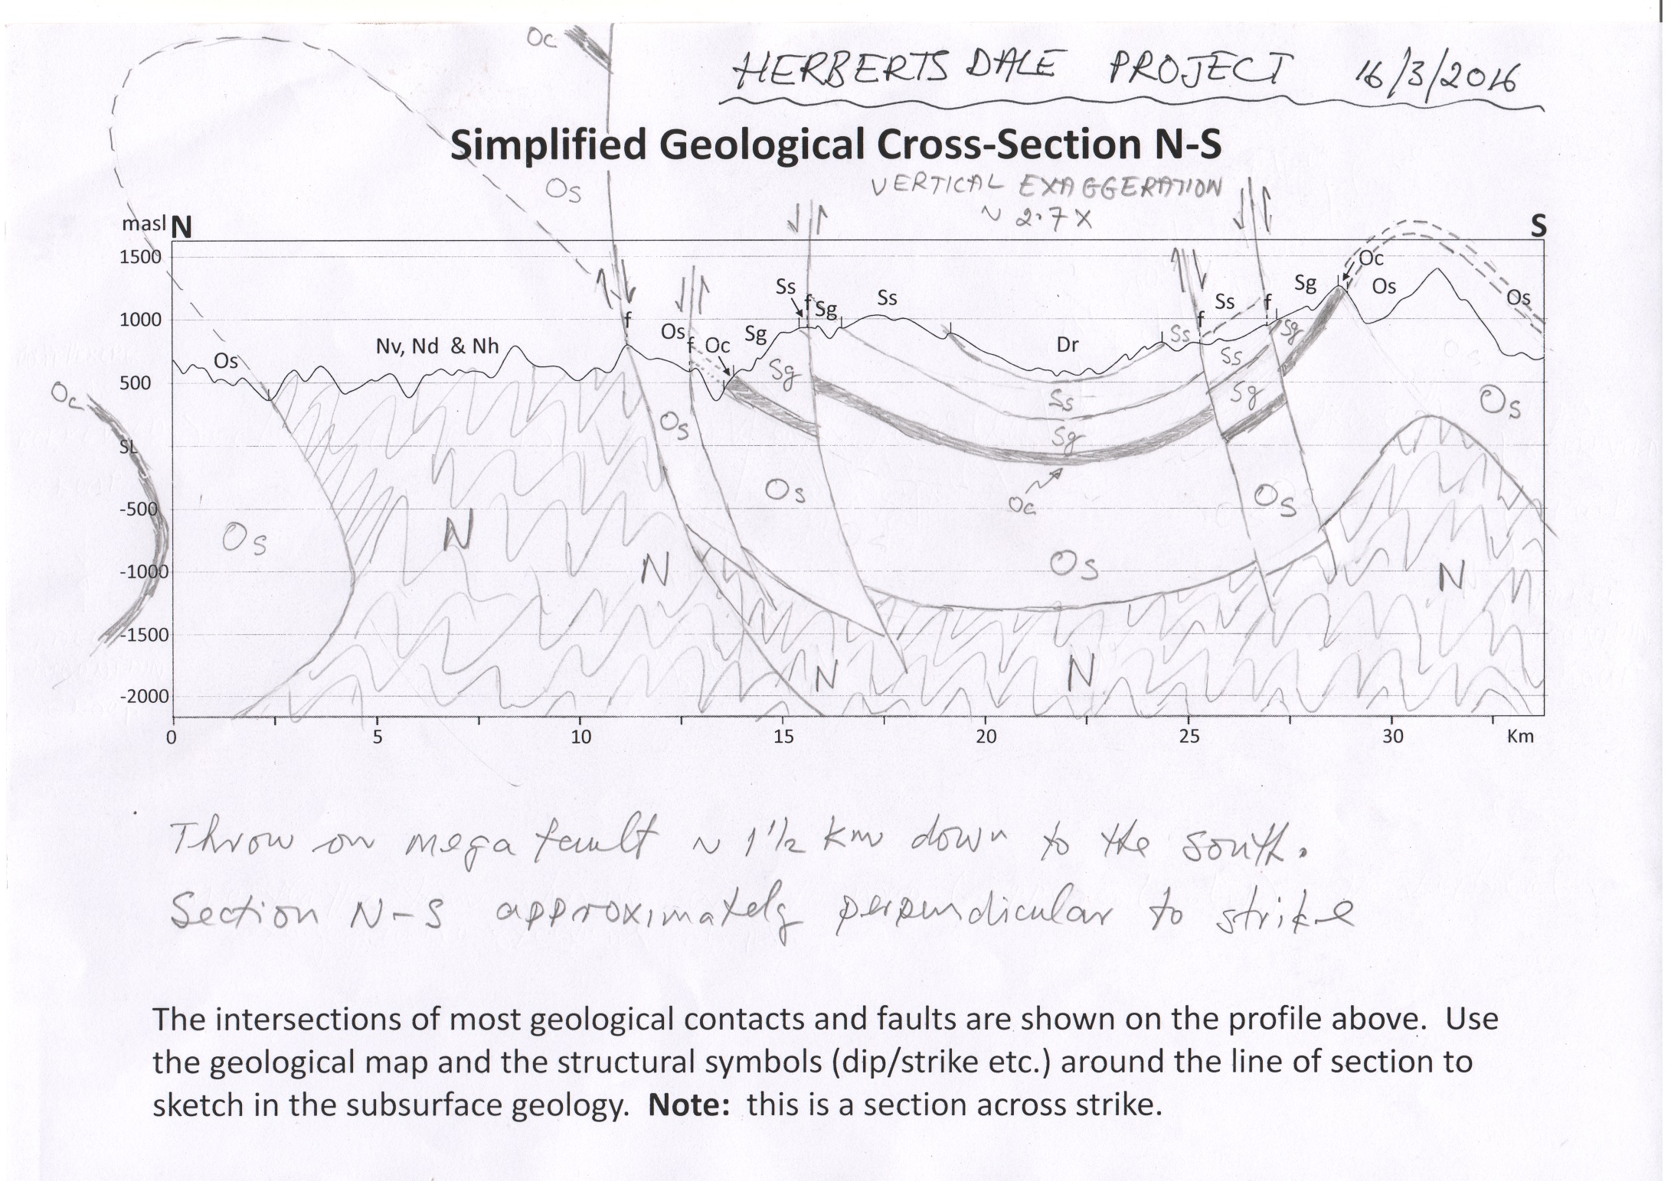
M
N

Slide 4
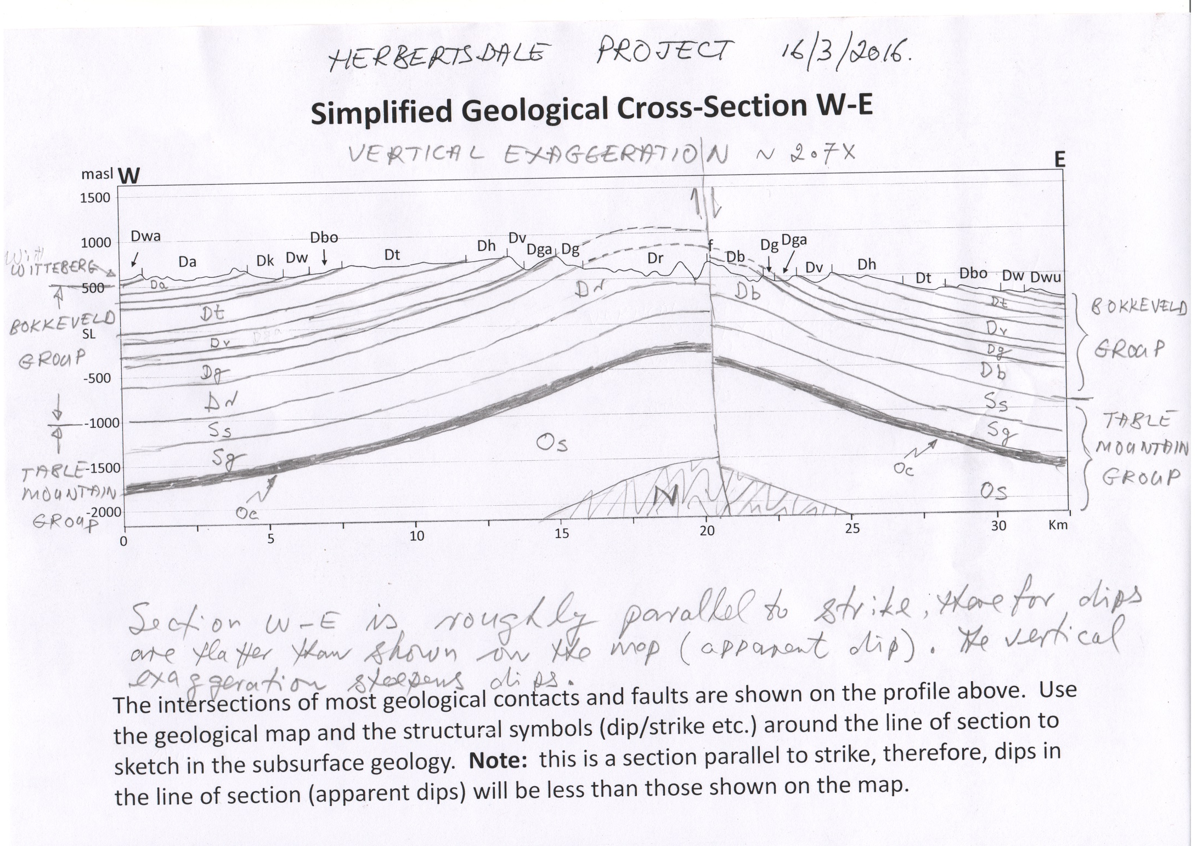
K
L

